Slide 1
SSW-555: Agile Methods for Software Development
Crystal
Instructor: Dr. Nafiseh Ghorbani
Department of Systems Engineering
Stevens Institute of Technology

Slide 2

Today's topic
Crystal Clear
- Properties
- Strategies
- Techniques
- Roles and work products
Crystal Clear vs XP
Crystal Family of Methods

Slide 3
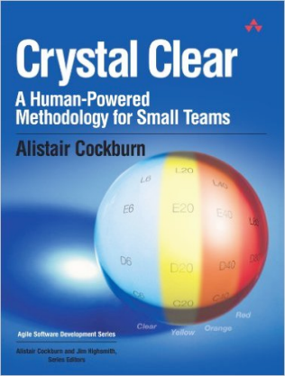
Acknowledgements
Agile Software Development by Alistair Cockburn
Crystal Clear: A Human-Powered Methodology for Small Teams by Alistair Cockburn

Slide 4
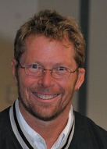
Alistair Cockburn on process and plans
“Focusing on skills, communications, and community allows the project to be more effective and more agile than focusing on processes and plans”
– Alistair Cockburn
Process and planning are important, but people, interactions, community, skills, and talent are more important

Slide 5
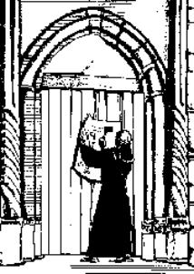
Agile Manifesto (2001)
We are uncovering better ways of developing software by doing it and helping others do it
Through this work we have come to value:
Individuals and interactions over processes and tools.
Working software over comprehensive documentation.
Customer collaboration over contract negotiation.
Responding to change over following a plan.
That is, while there is value in the items on the right, we value the items on the left more.

Slide 6
FDD’s view on the Agile Manifesto
Individuals and interactions over processes and tools.
Focus on people: Agile values collaboration, creativity, and communication among team members over rigid processes or tools.
Collaboration is key: Open, face-to-face interactions help teams respond to changes and solve problems efficiently.
Adaptability: Tools and processes should be flexible and adjusted to support the team’s needs, not dictate the work.
Empowerment: Teams are encouraged to make decisions and solve issues together, rather than relying on predefined rules or tools.
In short, Agile emphasizes the importance of people working together effectively rather than strictly following processes or tools.

Slide 7
Alistair Cockburn on process and plans
Many teams follow the letter of the process rather than the spirit of the process:
Some teams strictly adhere to the formal rules or procedures of a given process (the "letter of the process") but miss the underlying principles or goals (the "spirit of the process").
In the context of Agile, it suggests that a team may follow Agile ceremonies, practices, or frameworks exactly as prescribed, but without truly understanding or embracing the core values of Agile, such as flexibility, collaboration, and delivering value.

Slide 8
Alistair Cockburn on process and plans
Many teams follow the letter of the process rather than the spirit of the process:
For example, a team might have daily stand-ups, sprint reviews, and retrospectives (the letter of the process) but still fail to focus on adapting to change, continuous improvement, or delivering customer-centric solutions (the spirit of the process).
Essentially, it’s a critique that some teams might be going through the motions without genuinely embodying the mindset and values that Agile promotes.

Slide 9
Crystal (1992)
Alistair Cockburn interviewed successful projects and extracted the processes that helped lead to success
Teams were succeeding without traditional formal methods
Crystal is a family of methods and a set of guidelines that you adjust to meet your project’s needs
Different flavors of Crystal for different Just as no two crystals are the same, no two projects are the same
E.g., small projects vs large projects
Tailor the process to the project

Slide 10
Crystal Clear
Crystal Clear is the lightest member of Crystal family
Similar to eXtreme Programming
Intended for small, collocated teams (1-6 members)
 |  | Crystal Methodologies
 |  | Clear | Yellow | Orange | Red | Maroon
Critically of the Project | Life (L) | L6 | L20 | L40 | L80 | L200
 | Essential Money (E) | E6 | E20 | E40 | E80 | E200
 | Discretionary Money (D) | D6 | D20 | D40 | D80 | D200
 | Comfort (C) | C6 | C20 | C40 | C80 | C200
 |  | 1 to 6 | 7 to 20 | 21 to 40 | 41 to 80 | 81 to 200
 |  | Number of People involved in the Project
Source: Crystal Clear: A Human-Powered Methodology for Small Teams

Slide 11
Crystal: criticality of the project
In the context of different Crystal methodologies, terms like Life, Essential Money, Discretionary Money, and Comfort are often used to illustrate the trade-offs between the level of flexibility, communication, and formal processes required for a project.
These terms may be linked to the way Crystal defines different methodologies based on the size and complexity of the project, which is reflected by different colors (Clear, Yellow, Orange, Red, and Maroon). Here's a breakdown:
1. Life:
In Crystal, Life refers to the balance between the project's critical elements (like customer value, team health, and the product’s outcome) and how they are sustained over time.
Life often implies the project's longevity and overall well-being, making sure it is sustainable.
In simpler terms, it’s about managing a project in a way that ensures its continuity and success over the long haul.

Slide 12
Crystal: criticality of the project
2. Essential Money:
This refers to the minimum amount of resources (funding, effort, time) necessary to deliver the core product or feature in a Crystal methodology.
Essential money is the amount needed to make the project succeed without extraneous extras or unneeded overhead.
It’s the budget required to cover the basic, essential requirements of a project.

Slide 13
Crystal: criticality of the project
3. Discretionary Money:
Discretionary money refers to additional resources that can be allocated to non-essential features or enhancements.
This would be the extra budget that allows for improving the project beyond the core needs.
In Agile terms, it might be for things like polishing the user experience or adding "nice-to-have" features that improve the overall value of the product but aren't strictly necessary for success.
The concept is about prioritizing what’s most valuable, with the flexibility to spend on enhancements as needed.

Slide 14
Crystal: criticality of the project
4. Comfort:
Comfort refers to the ease or relaxation of project constraints, such as the level of process rigor, communication intensity, or overall team structure.
In a methodology like Crystal, the level of comfort varies with the complexity and scale of the project.
The more comfort you have, the more relaxed or adaptable the project can be.
This is about how much flexibility and freedom the team has to manage the work without being overly constrained by rigid processes or excessive oversight.

Slide 15
Crystal: criticality of the project
In Summary:
Life: Ensuring the sustainability of the project.
Essential Money: The minimum necessary resources for success.
Discretionary Money: Extra resources for non-essential, value-adding features.
Comfort: How rigid or flexible the team can be in following processes.
As the project size and complexity increase, Crystal methodologies require more structure and resources, as indicated by the shift from Clear (least formal) to Maroon (most formal).

Slide 16
Crystal Methodologies: How Colors Relate to These Concepts
Clear (or Crystal Clear):
Life: High focus on team collaboration, often with a very light process.
Essential Money: Minimal resources are needed since the project is small and focused on core deliverables.
Discretionary Money: Not much; the emphasis is on simplicity and delivering value.
Comfort: High; the team has a lot of freedom and flexibility to adapt.
So, clear is for small teams and low-complexity projects, so it involves less overhead and more flexibility.

Slide 17
Crystal Methodologies: How Colors Relate to These Concepts
Yellow (or Crystal Yellow):
Life: Balanced attention to both long-term viability and iterative progress.
Essential Money: A bit more resources than Clear, but still minimal.
Discretionary Money: You might have some extra flexibility in terms of features, but it's still mostly focused on essentials.
Comfort: Moderate; some formal processes (like regular iterations) but still relatively flexible.
So, yellow is for medium-sized teams and moderate complexity.

Slide 18
Crystal Methodologies: How Colors Relate to These Concepts
Orange (or Crystal Orange):
Life: More defined structures are needed for ensuring the long-term success of the project, focusing on scalability and managing larger teams.
Essential Money: More resources are required compared to Yellow due to larger project complexity.
Discretionary Money: Some flexibility for extra features or non-critical requirements.
Comfort: Less comfort; a more structured approach is required, with defined roles and processes.
So, orange is for medium to larger teams where more structure is needed to manage complexity.

Slide 19
Crystal Methodologies: How Colors Relate to These Concepts
Red (or Crystal Red):
Life: Focused on long-term viability and the ability to scale for large teams.
Essential Money: Significant resources required due to the scale of the project.
Discretionary Money: Some extra budget available for additional features or quality improvements.
Comfort: Low comfort; more formalized processes and stricter adherence to practices.
So, red is for large teams and highly complex projects that require more structure and formal practices to handle the increased risk and complexity.

Slide 20
Crystal Methodologies: How Colors Relate to These Concepts
Maroon (or Crystal Maroon):
Life: Long-term survival of the project is critical, and great attention is paid to keeping it sustainable over time.
Essential Money: Large-scale budgets are required, and resources are allocated for both essential and non-essential aspects.
Discretionary Money: Significant resources for features that improve quality but aren't strictly necessary for the product's core value.
Comfort: Low; extensive formal processes and more rigid management.
So, maroon is typically for very large and complex organizations or projects, requiring a lot of formal process, structure, and resources.

Slide 21




Properties, Strategies,Techniques
In Crystal methodology, the concepts of properties, strategies, and techniques help tailor Agile practices to a project's needs.

Slide 22
Properties
Properties: These are key characteristics of the project, such as:
Team size (small, medium, large)
Criticality (importance of the software)
Lifespan (short-term or long-term)
Dynamism (rate of change)
Properties should be true about any project
e.g., Principles in the Agile Manifesto

Slide 23

Properties across all Crystal Methods
1 Frequent delivery (Clear)
Intervals of 2 weeks to 4 months
Tune Crystal parameters to your project’s needs
2 Reflective improvement (Clear)
“Reflection workshop” every few weeks, e.g., after every delivery
Review what parts of process worked and what needs to change
Analogous to Sprint Retrospective

Slide 24


Properties across all Crystal Methods
3 Osmotic communication (Clear)
See, hear, and absorb information in background
Improves communication across team
All team members are aware of others’ work and can help or take over if needed
Goal: communications and community
Osmotic communication is about the informal, indirect, and often effortless flow of information or influence between people, environments, or systems.
It's not forceful or intentional but occurs organically, almost as if by diffusion.

Slide 25
Properties across all Crystal Methods
4 Personal safety
Everyone should be comfortable sharing ideas with everyone
Mutual trust across the team, including the “boss”
Speak up without fear of ridicule
5 Focus
Minimize interruptions from calls, email, meetings (At least two hours per day of uninterrupted time)
Clear direction and priorities for the project (Everyone knows what to work on)
People have time and peace of mind to work

Slide 26
Properties across all Crystal Methods
6 Collaboration across organizational boundaries
Breaks down silos by encouraging teamwork across departments.
Fosters open communication to ensure information is shared and understood.
Improves decision-making by incorporating diverse perspectives.
Aligns goals to ensure teams work towards a common vision.
Increases flexibility for quick responses to changes or issues.
Supports continuous delivery with smooth cross-team coordination.
Encourages cross-functional skills and knowledge sharing.
Creates shared responsibility for project success.
Boosts innovation through diverse team contributions.
This collaboration ensures more effective and efficient software development.

Slide 27
Properties across all Crystal Methods
6 Easy access to domain experts
Onsite or via regular meetings
Analogous to onsite experts from eXtreme Programming
7 Technical environment
Automated tests
Configuration management
Frequent/Continuous integration

Slide 28
Strategies
Strategies: These are guiding principles for managing the project, such as:
Frequent delivery of working software
Reflective improvement through feedback
Close collaboration with stakeholders
Technical excellence and personal safety within the team
Strategies are a plan to accomplish a goal
Higher level approaches to solving problems

Slide 29
Strategies
1 Exploratory 360
Planning at the beginning of the project Early requirements and domain model
Demonstrations of feasibility
2 Early victory
Focus on an easy first deliverable
Winning helps the team to bond and feel successful

Slide 30

Strategies
3 Walking skeleton
Tiny end-to-end version of the system’s functionality
Provides a simple model for the user to explore
System evolves from this first architecture
4 Incremental re-architecture
Be prepared to change the architecture
Have a fallback or temporary solution (a short-term hack)
Evolve to the new architecture through parallel effort

Slide 31

Strategies
5 Information radiators
Display useful information through osmotic communication
Updated continuously
E.g., Burn down chart to display status and progress

Slide 32
Techniques
Techniques: These are specific practices used to implement strategies, such as:
Frequent releases of small increments
Pair programming
Automated testing
Simple design
Techniques are things you do
Skills that the team can develop and use to solve problems
By adjusting properties, strategies, and techniques, Crystal customizes Agile practices to fit the unique needs of each project.

Slide 33
Techniques
1 Methodology shaping to define the process
Conduct interviews to collect information about the team
Conduct workshop to define an optimal process for this team
2 Reflection workshop
Hour-long meeting after each delivery
What are we doing well?What can we do better?
How can we improve our process?
Analogous to Sprint Retrospective
Keep these test lock-down quiet time daily meetings | Try these pair testing fines for interruptions programmers help testers
Problems too many interruptions shipping buggy code

Slide 34
Techniques
3 Blitz planning/Planning “Jam Session”
Like XP's Planning Game
Create initial project plan
Include all stakeholders (Executive sponsor, users, developers)
Planning Game vs Blitz Planning
Planning Game | Blitz Planning
User Stories | Tasks
Assume no dependencies between stories | Explicity analyze dependencies between tasks
Fixed length sprints | Variable iteration durations

Slide 35
Techniques
Blitz Planning (or Planning Jam Sessions) is a technique in Crystal Methods (an agile methodology) designed to quickly and collaboratively plan a project or a feature.
It’s a fast, time-boxed approach that encourages input from the entire team, enabling rapid decision-making and alignment.
Blitz Planning / Planning Jam Session in Crystal Methods:
Time-Boxed Sessions:
Blitz Planning is a quick, focused meeting where the team plans a project or feature in a short, set period (usually a few hours to a day).
It emphasizes speed and efficiency while ensuring all necessary elements of planning are covered.
Collaborative and Inclusive:
The entire team, including developers, testers, product owners, and other stakeholders, participate in the planning session.
Diverse perspectives from all involved roles help build a shared understanding and approach.

Slide 36
Techniques
Blitz Planning / Planning Jam Session in Crystal Methods:
Focused on the High-Level Plan:
The goal is to develop a high-level plan for the project or feature, without getting bogged down in minute details.
It typically covers key elements like goals, milestones, deliverables, timelines, and major risks.
Shared Understanding of Goals and Requirements:
The team works together to clarify requirements, priorities, and expectations from the project.
Ensures everyone is on the same page about the desired outcomes and what success looks like.
Rapid Decision-Making:
Blitz Planning encourages fast decision-making to avoid delays and keep the project moving forward.
There’s a focus on making quick but informed choices, rather than lengthy discussions.

Slide 37
Techniques
Blitz Planning / Planning Jam Session in Crystal Methods:
Adjustments as Needed:
It’s flexible, with room for adjustments during the process. The goal is to adapt as more information becomes available, rather than locking in rigid plans early on.
Creates Immediate Actionable Items:
At the end of a Blitz Planning session, the team has a clear roadmap for immediate actions, with tasks and responsibilities assigned.
Fosters Team Alignment:
Everyone leaves the session with a unified vision and understanding of the project, which promotes strong team alignment and reduces ambiguity.

Slide 38
Techniques
Blitz Planning / Planning Jam Session in Crystal Methods:
Key Benefits:
Speed: Quickly sets the direction for the project without overthinking details.
Alignment: Helps the team agree on a shared vision and approach.
Focus: Keeps everyone focused on the big picture, ensuring progress is made rapidly.
Engagement: Everyone involved has a chance to contribute their insights, leading to better buy-in and commitment.
In summary, Blitz Planning in Crystal Methods is an effective technique for quick, collaborative, and high-level project planning that aligns the team, sets clear goals, and ensures swift action while remaining adaptable.

Slide 39
Blitz Planning Cards
Blitz Planning Cards are a tool used in Crystal Methods for fast, collaborative project planning. They help teams quickly cover key areas of a project, such as goals, risks, requirements, resources, and timelines. The cards are time-boxed and encourage input from all team members to create a shared, high-level plan.
Key Points:
Time-boxed: Focuses on quick, efficient planning.
Collaborative: Involves the entire team to ensure diverse input.
Structured: Cards represent key planning areas (goals, risks, resources).
Flexible: Can be customized to fit the project’s needs.
Visual: Cards can be used visually to track progress and discussions.
This approach promotes alignment, clarity, and quick decision-making, allowing teams to start projects with a clear, shared plan.

Slide 40
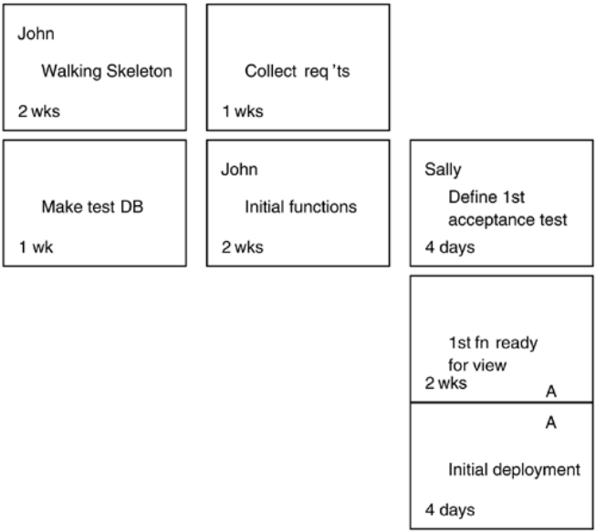
Blitz Planning Cards
Time
Dependenc
ies
• Identify tasks
• May identify task owner
• Identify task duration
• Identify task order and dependencies

Slide 41
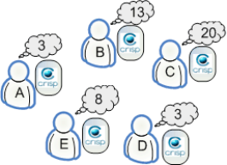
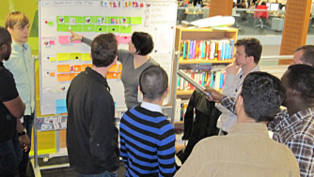
Techniques
4 Delphi estimation
Iterative estimation by groups
Achieve convergence through
Planning Poker
5 Daily stand-ups
Borrowed from Scrum
What did I accomplish since last time?
What’s my goal for today?
What problems do I have?

Slide 42
Daily Standup Meeting
Creative ways to limit the length of the daily standup
https://www.linkedin.com/pulse/daily-plank-meeting-going-agile-literally-jeyaraj-nagarajan

Slide 43

Techniques
6 Agile interaction design
User-centered design
What would the user want?
How will the user use the system?
Focus on roles of users
Human Computer Interaction (CS 545)
Usability testing

Slide 44

Techniques
7 Process miniature
Train participants on processes with short exercises
Peter Merel’s “Extreme Hour” to learn XP
Walk through all aspects of XP on simple project in 60 minutes

Slide 45
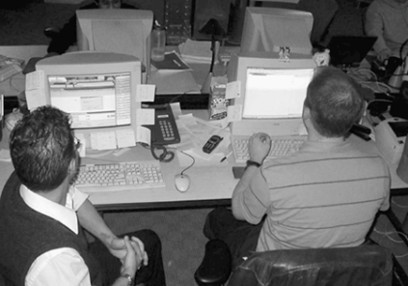
Techniques
8 Side-by-side programming
Sit close enough to see one another's screens
Not quite pair programming: Help is available when needed, but not constant
Osmotic communication

Slide 46
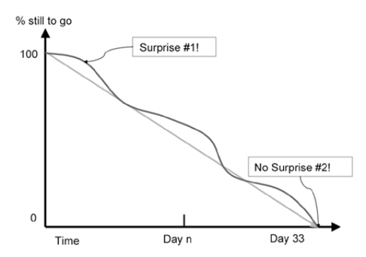
Techniques
9 Burn charts
Display progress against goals Borrowed from Scrum

Slide 47
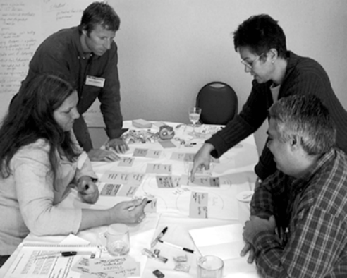
Role modeling session
Each card represents a feature or user story
Specify the goal on the card
Work through a scenario of a user accomplishing a task

Slide 48
Roles and Work Products
Smaller projects require fewer roles:
Executive Sponsor:
Mission statement
Team:
Team structure and conventions
Reflection workshop results
Coordinator/Manager:
Project map
Release plan
Project status
Risk list
Iteration plan and status
Viewing schedule

Slide 49
Roles and Work Products
Larger projects require additional roles:
Business expert and expert user:
Actor-goal list
Use cases and requirements file
User role model
Lead designer:
Architecture description
Tester:
Bug reports
Designer-programmer:
Screen drafts
Common domain model
Design sketches and notes
Source code
Migration code
Tests
Packaged system
Writer:
User help text

Slide 50
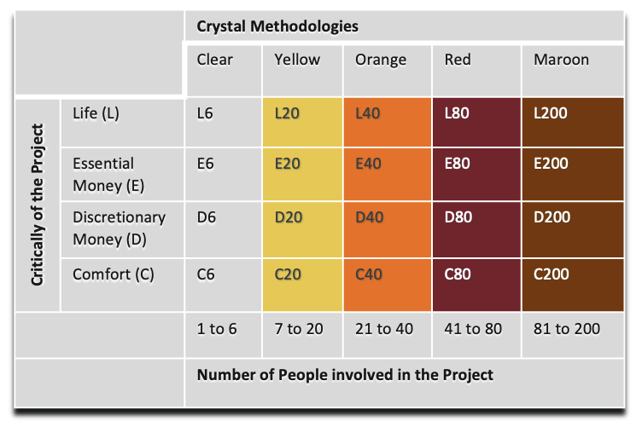


Crystal Clear vs eXtreme Programming
Many similarities, but …
Cockburn claims that:
XP requires more discipline than Crystal Clear
XP has 12 mandatory practices e.g., Pair Programming,TDD, …
XP can be more productive than Crystal Clear
It is easier to start using Crystal Clear
Especially for Plan Driven teams
It is easy to fall back from XP to Crystal Clear
Use only the XP practices that work for your project

Slide 51
The family of Crystal Methods
A single process is not likely to work for all projects
Adapt your method according to:
Size in staff:
1 – 6 (Crystal Clear)
7 – 20 (Crystal Yellow)
21 – 40 (Crystal Orange)
41 – 80 (Crystal Red)
Potential risks for causing damage
Comfort (C)
Discretionary money (D) – the company will survive if the project fails
Essential money (E) – the company may fail if the project fails
Life (L) – safety critical
Note: Life (safety critical projects) should NOT use Crystal Methods

Slide 52
Crystal Orange
Roles:
Sponsor
Business expert
Usage expert
Technical facilitator
Business analyst/designer
Project manager
Architect
Design mentor
Lead designer
UI designer
Reuse point
Writer
Tester
Work Products:
Requirements document
Release sequence
Schedule
Status reports
UI design document
Common object model
Inter-team specifications
User manual
Source code
Test cases
Migration code
Team and sub-team:
System planning
Project Monitoring
Architecture
Technology
Functions (divided into cross-functional groups)
Infrastructure
External test

Slide 53
Katie's sessions
"Katie's sessions" could refer to a series of technical meetings, workshops, or training sessions led by a software engineer or industry expert named Katie.
These sessions could cover a range of topics in software development, such as:
Code Review Sessions: If "Katie" is leading code review sessions, these would be meetings where developers present their code to others for feedback and suggestions on improving quality, performance, or maintainability.
Tech Talk or Workshops: Katie could be hosting learning sessions or workshops on specific technologies, tools, or programming languages. These sessions might be aimed at improving the team's skills, exploring new tech trends, or solving specific engineering challenges.
Onboarding Sessions: If Katie is a lead or senior engineer, she might run onboarding sessions for new team members, helping them get acquainted with the development environment, processes, and best practices.
Pair Programming or Collaboration Sessions: In software engineering, "Katie's sessions" could also refer to pair programming or collaborative work sessions where developers work together to solve coding problems or build features.

